Slide 1
G2M Case Study
Virtual Internship
30-May-2022

Slide 2
Background-G2M (Cab Industry) case study
XYZ is a private equity firm in US ,due to remarkable growth in cab industry in last few years and multiple key players in the market ,it is planning for an investment in the cab industry.
Objective:Provide actionable insight to help XYZ firm in identifying the right company for making investment.

Slide 3
Data analysis:
Important points:
Data understanding
Identifying the relationship between them
Identifying the primary key
Merge all the tables into Masterdata
Data cleaning
Analyze it statically

Slide 4
Data exploration:
Cab data:359392 rows & 7 columns
City : 20 rows & 3 columns
Transcation ID:440098 rows & 3 columns
Customer ID:49171 rows & 4 columns
After merging all 4 tables into Master data:
359392 rows & 14 columns

Slide 5
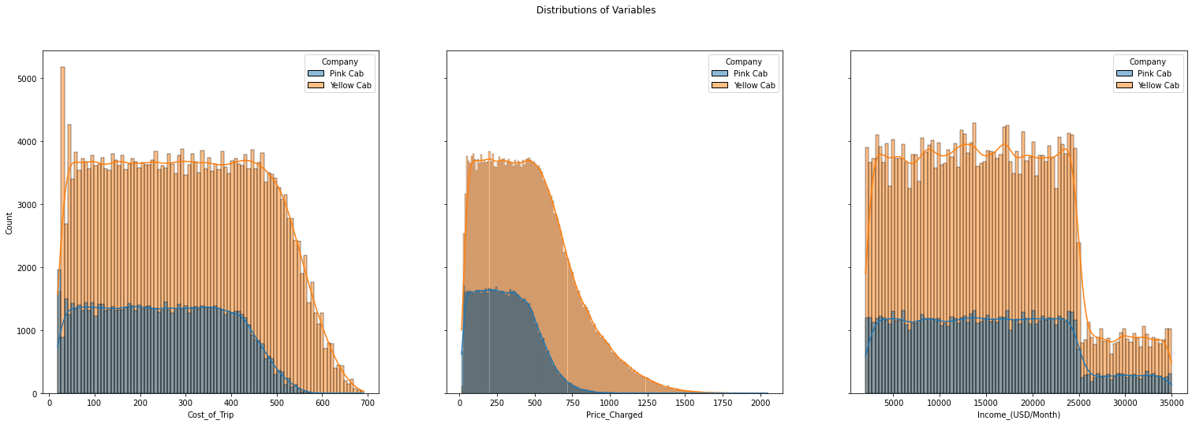
Data visuals:
Pink & Yellow cabs count vs cost of trips,price charged,income

Slide 6
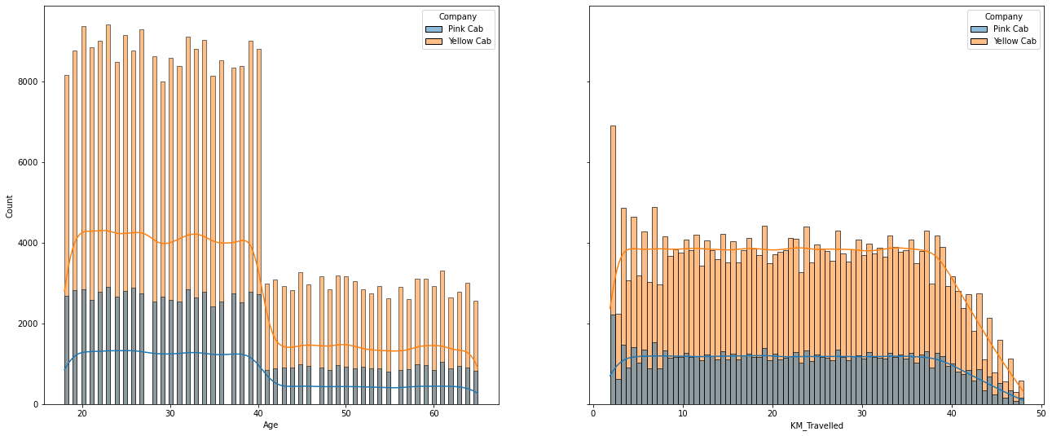
Pink & Yellow cab count vs age / km travelled:

Slide 7
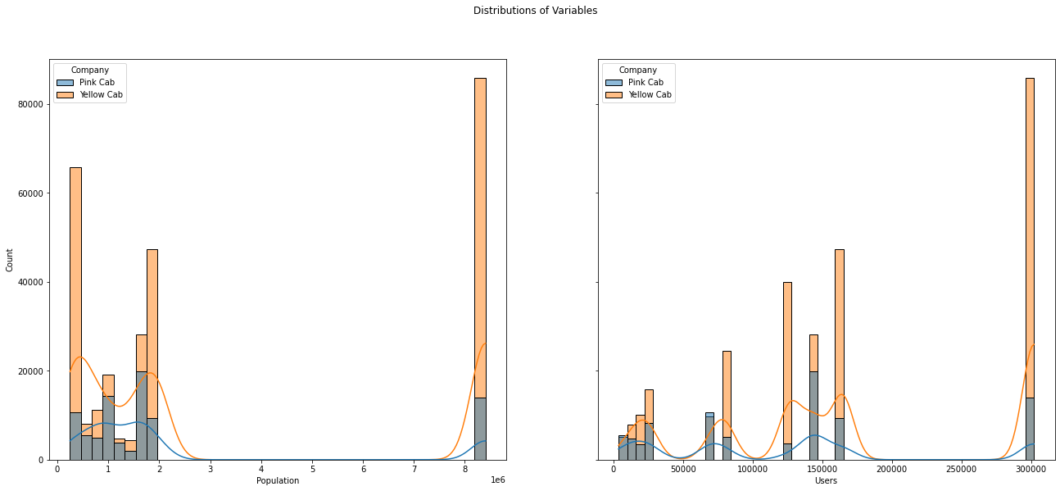
Pink & Yellow cab count Vs Population /Users:

Slide 8
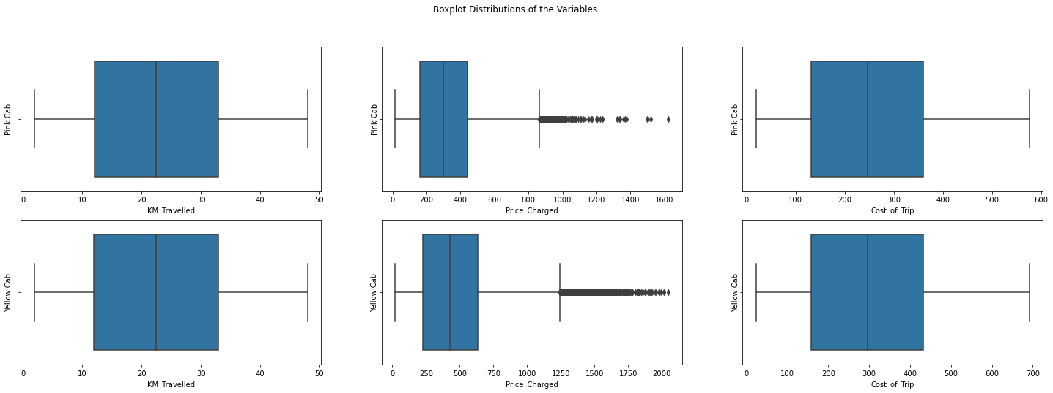
Box plot:

Slide 9
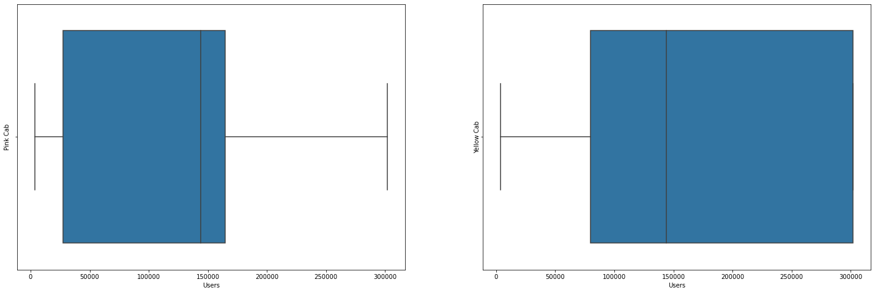
Pink & Yellow cab vs users:

Slide 10
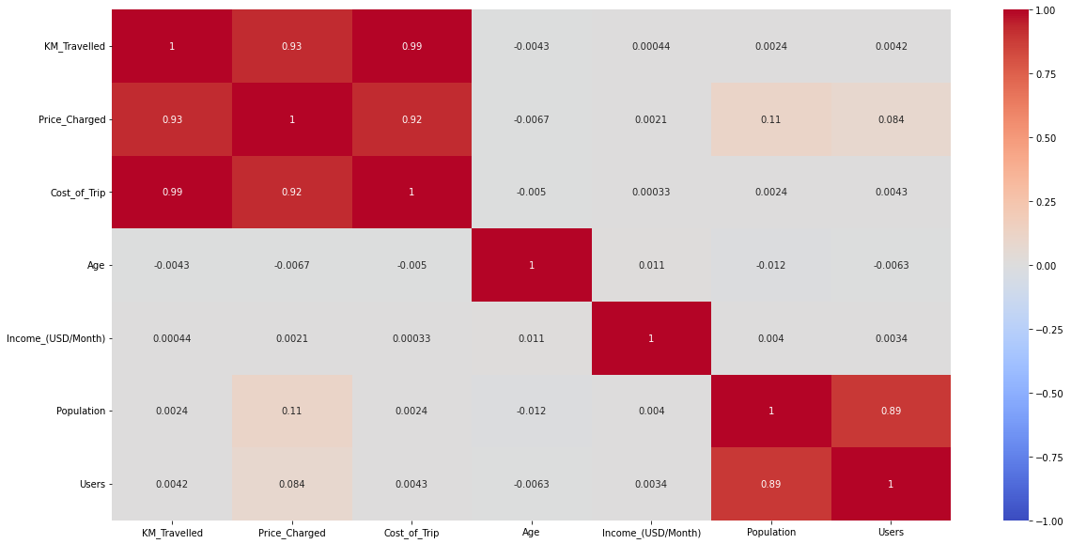
Heatmap for pink cab:

Slide 11
Pink & Yellow cab count Vs Population /Users:

Slide 12
Box plot:

Slide 13
Pink & Yellow cab vs users:

Slide 14
Heatmap for pink cab:

Slide 15
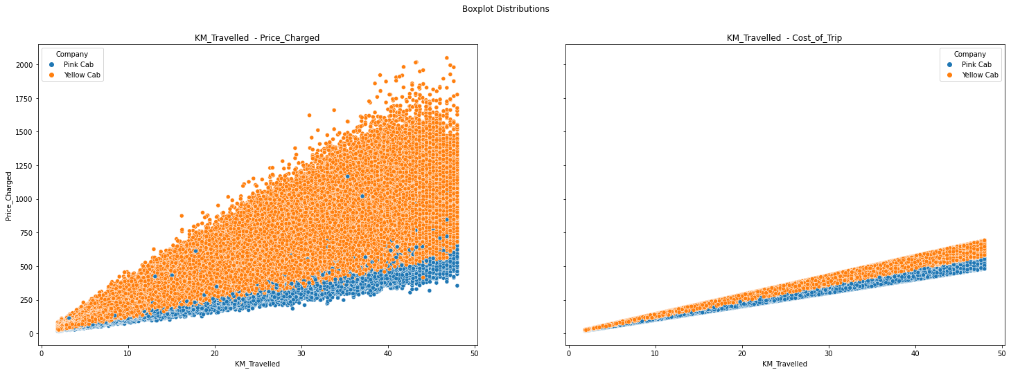
Km travelled & cost of trip

Slide 16
Km travelled & cost of trip

Slide 17
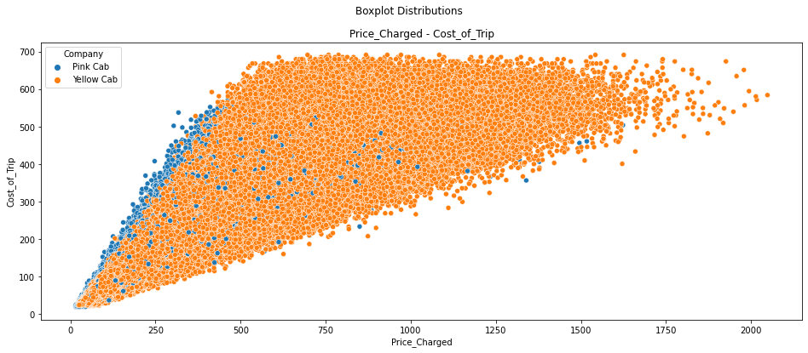
Price charged vs cost of trip

Slide 18
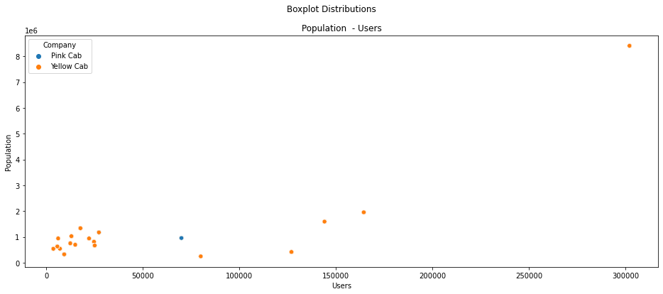
Population vs users

Slide 19
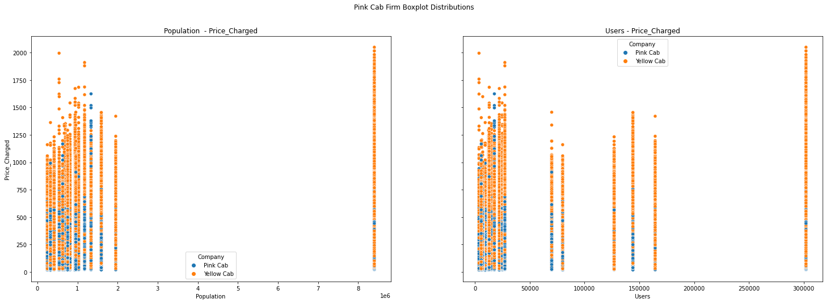
Population vs price charged

Slide 20
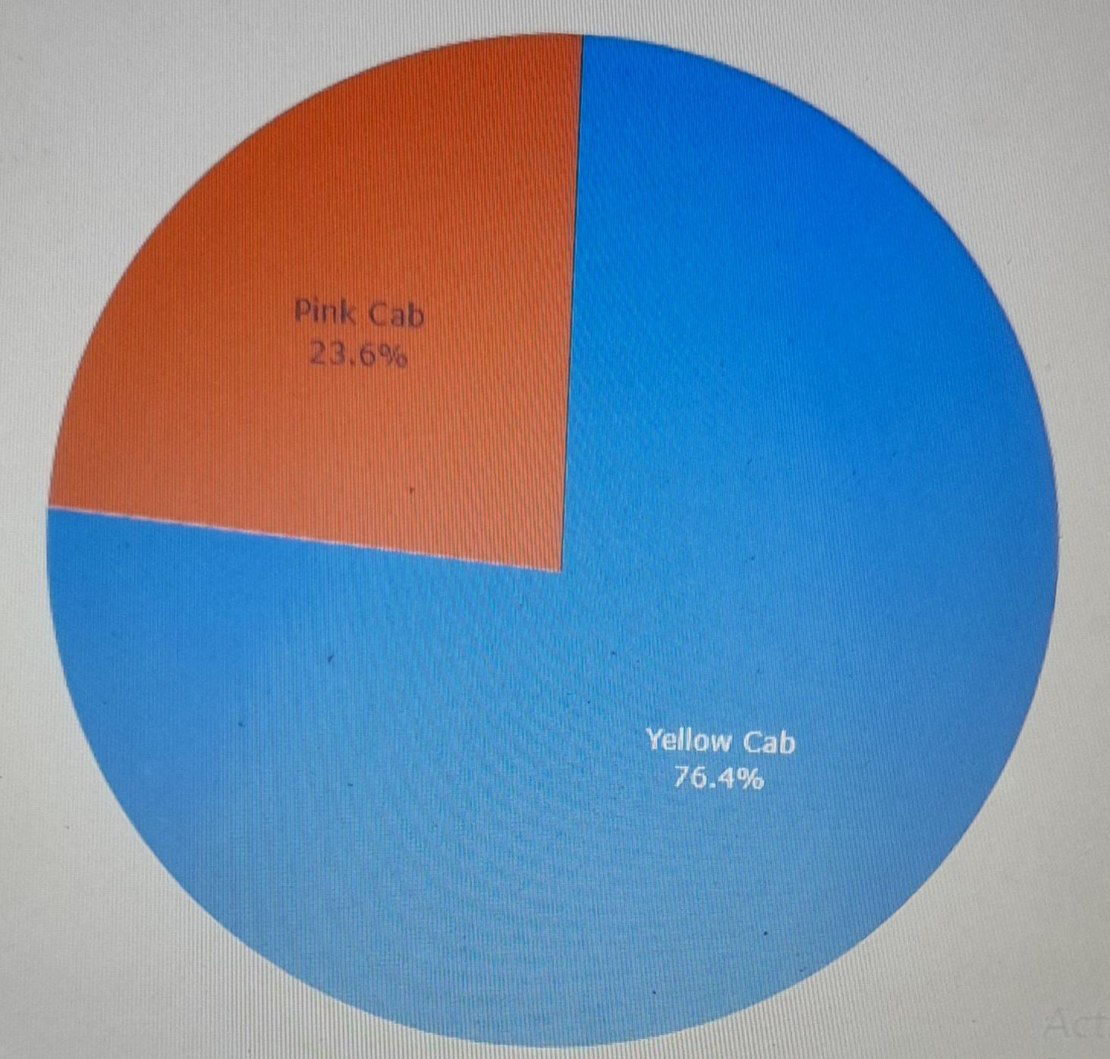
Pink & Yellow cab firms Total overview:

Slide 21
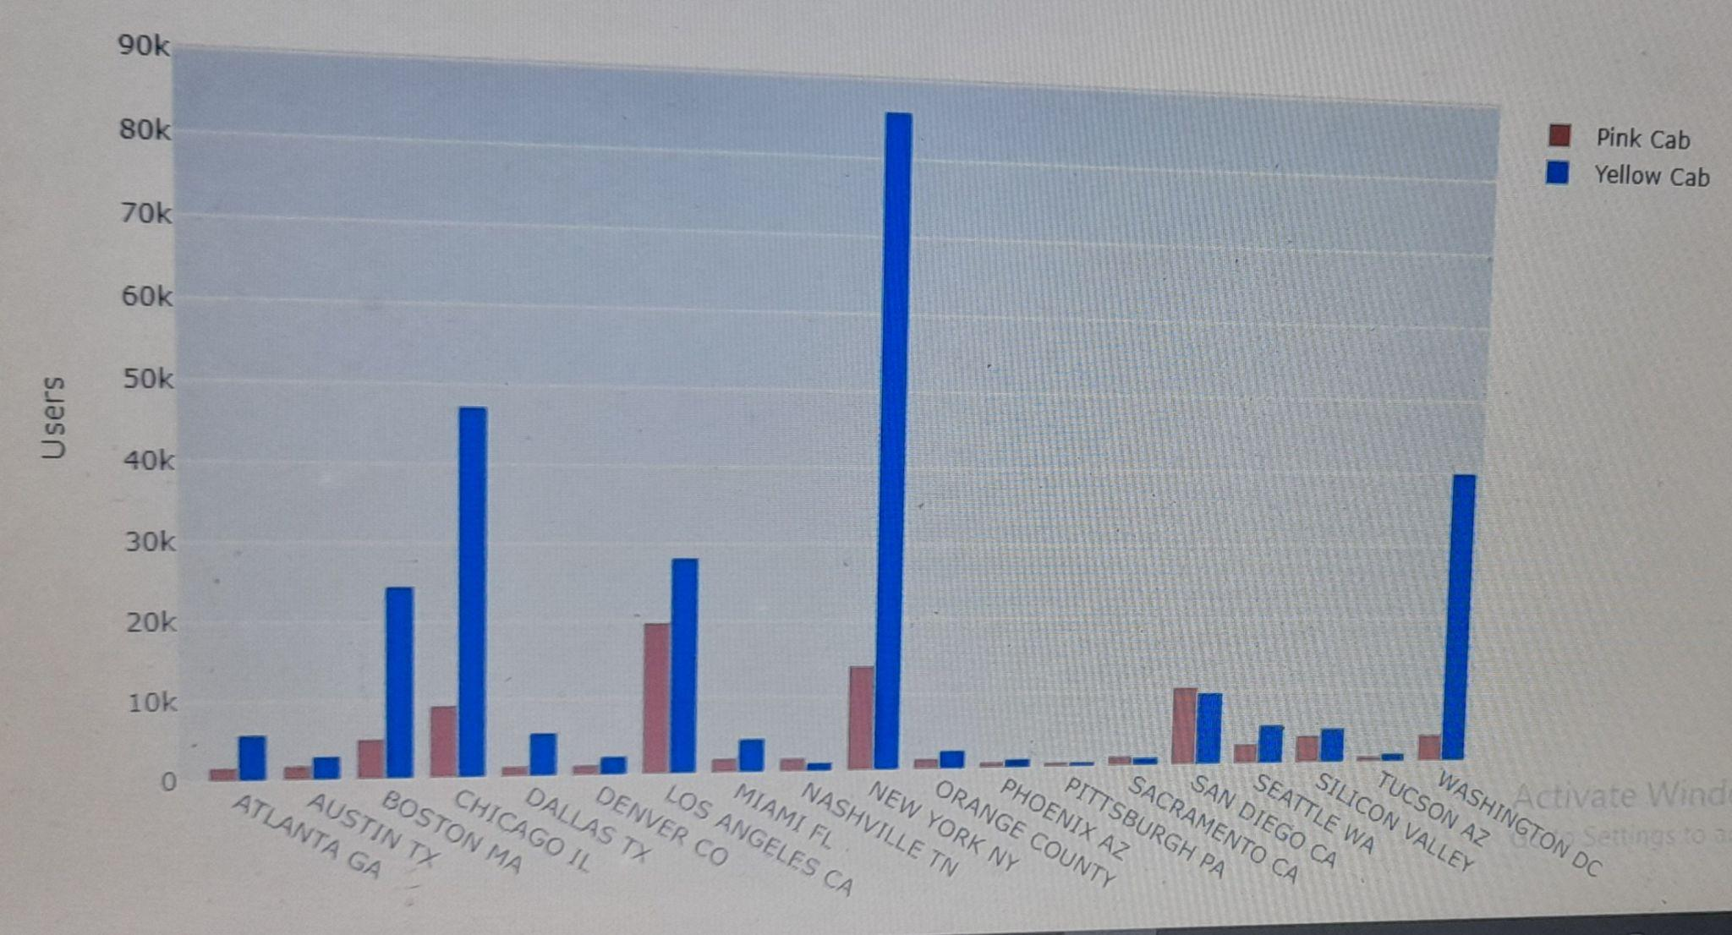
Pink & Yellow firm cab users distribution over city

Slide 22
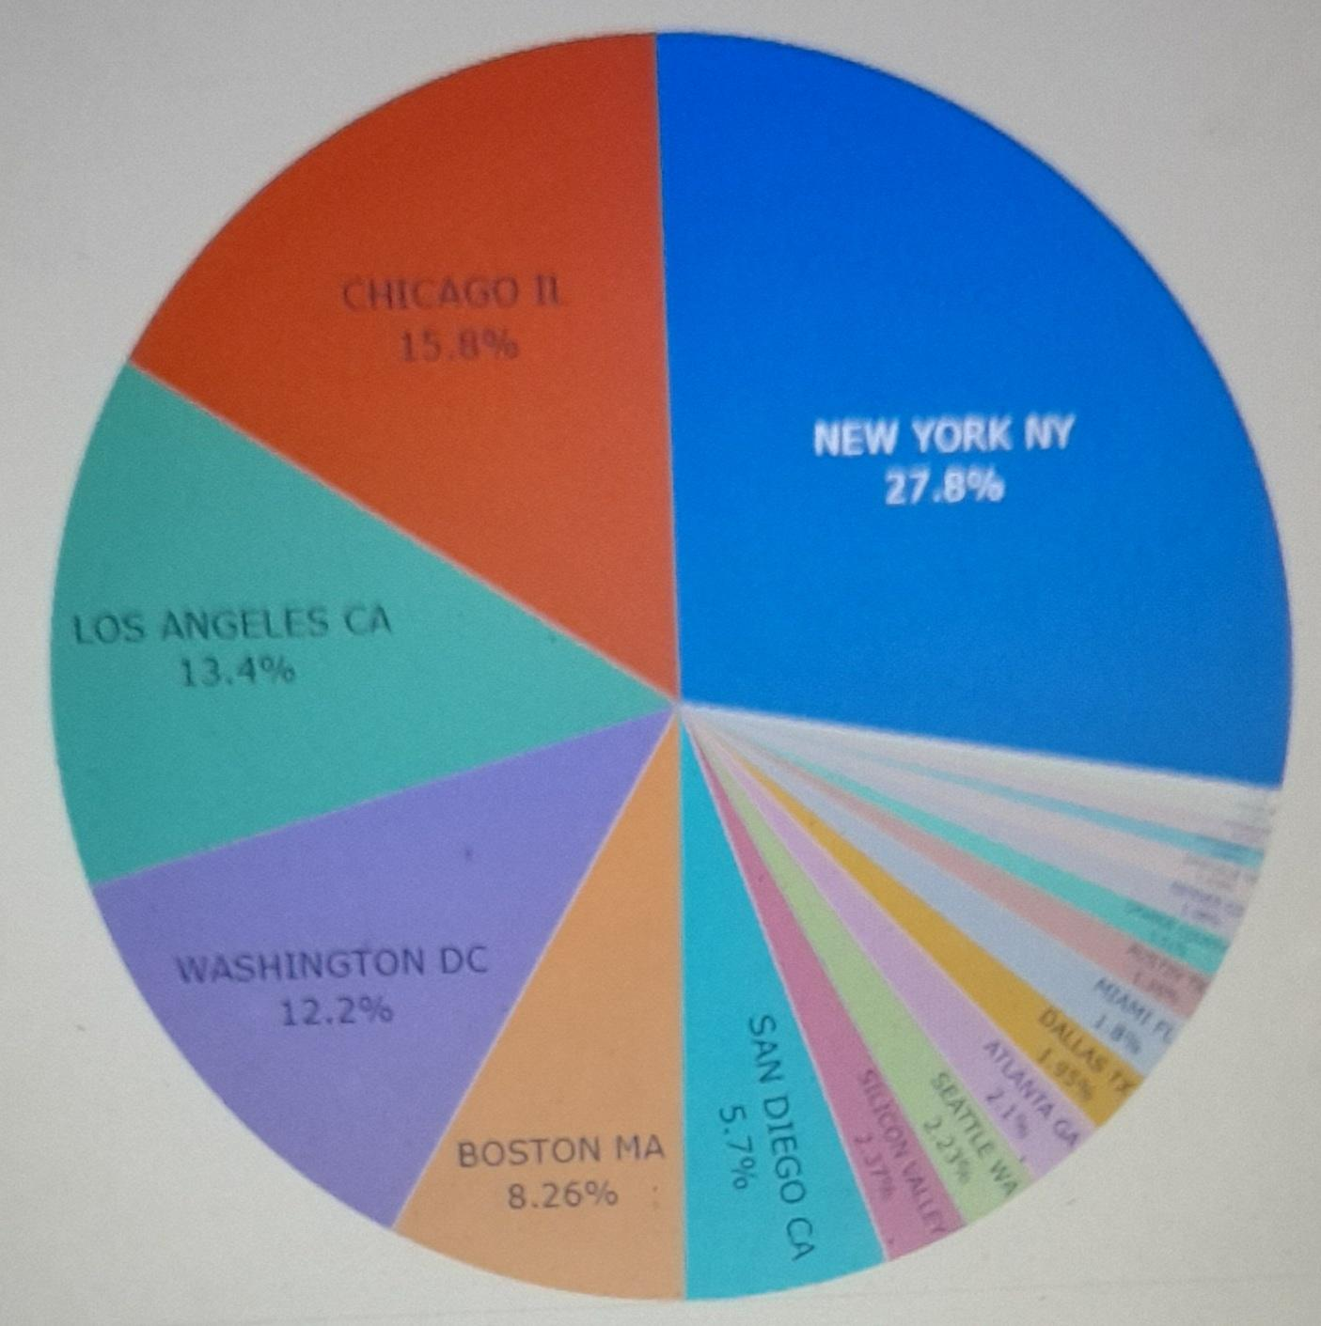
Total users overview by city

Slide 23
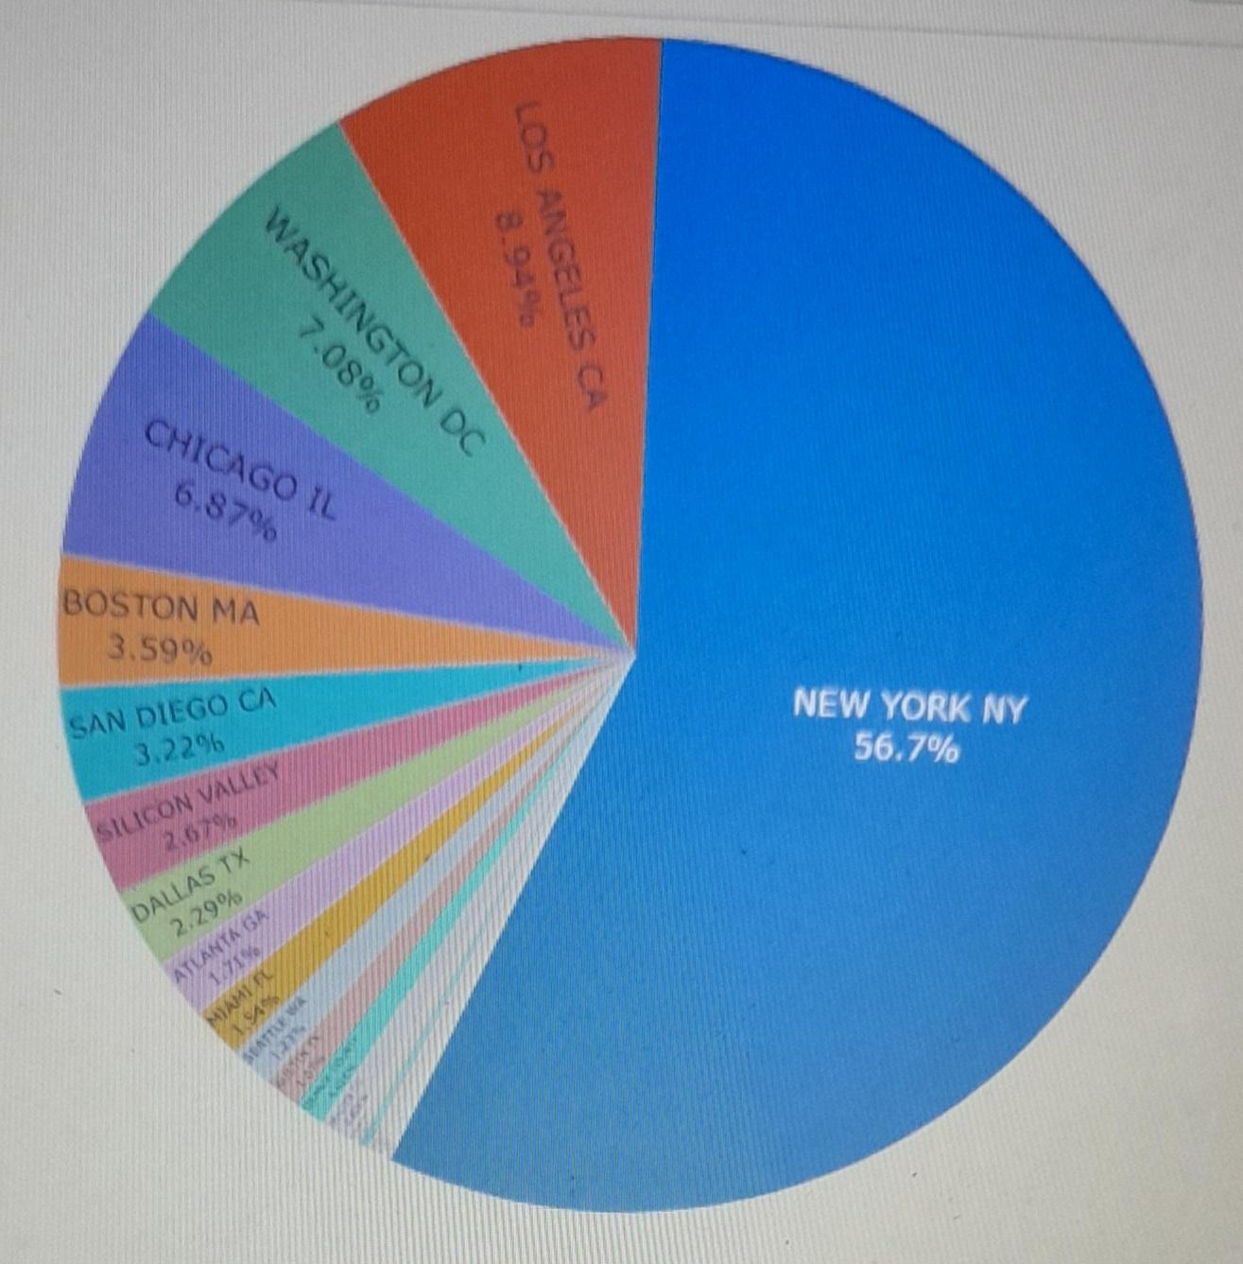
Total market profit share by city

Slide 24
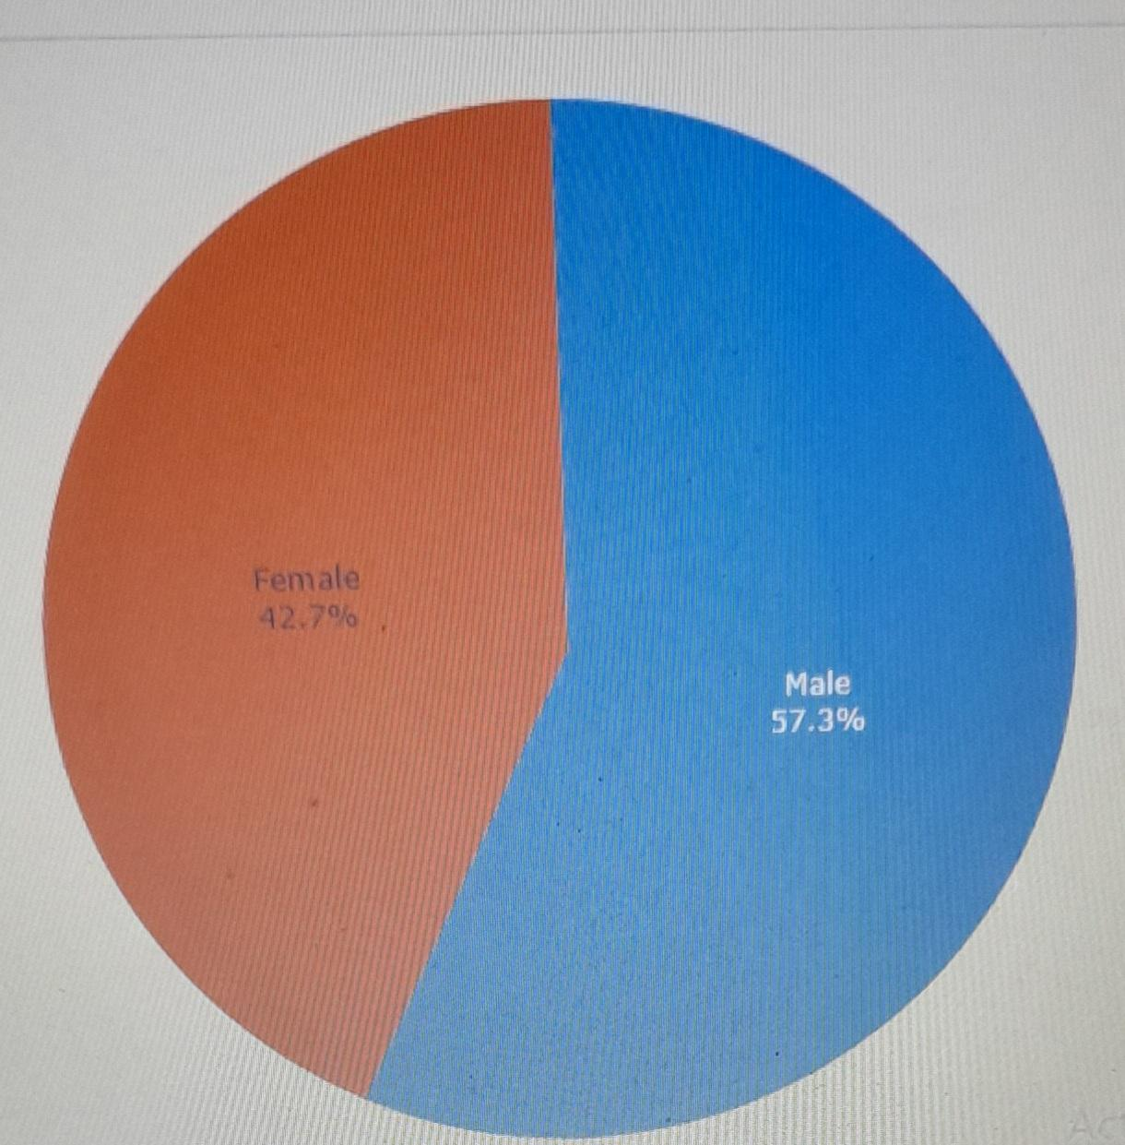
Total users overview by gender

Slide 25
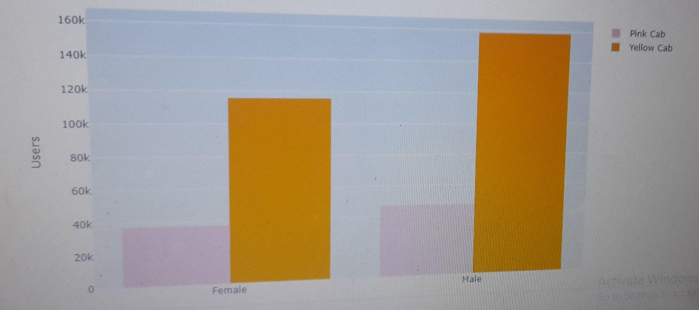
Pink & Yellow cab users distribution over gender

Slide 26
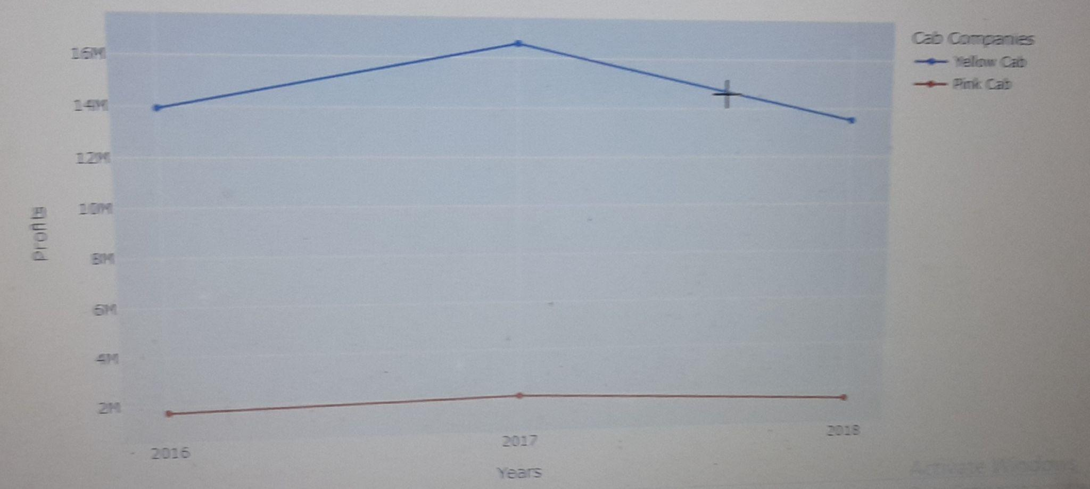
Total profit per year by cab firm

Slide 27
Recommendations
The total number of users of yellow cab is approximately 3 times of pink cab.
For yellow cab company highest number of users on a city basis are in New york ,Washington ,Chicago.
For pink cab company ,most are in Los Angeles,New york and San Diego.
On the basis of cities ,highest number of total users are in New york, Chicago,Washington,Boston,Los angeles.
More than half of total market share on the basis of cities belongs to Newyork
The total market profit share of Yellow cab is approximately 9 times of a pink cab.
In the distribution of users by gender ratio of men to women is 3:2

Slide 28
Distribution of users by gender on company basis male :female ratio is 57.6%:42.4% in yellow cab & 55.9%:44.1% in pink cab
Credit card :cash payment ratio is 3:2.
Half of users are of age of 18-25
Average income of all users by city is approximately equal
Average income of all users by company is equal
The total travelled in km in yellow cab is 3 times of pink cab
The average profit per travelled in km by cities is equal

Slide 29
Final conclusion:
When we consider both cab firms in terms of total market profit share,total user share,yearly market profit share,total travelled in km by users,we recommended:
YELLOW CAB FIRM

